Slide 1
Algorithms
Lecture # 01
Dr. Sohail Aslam

Slide 2
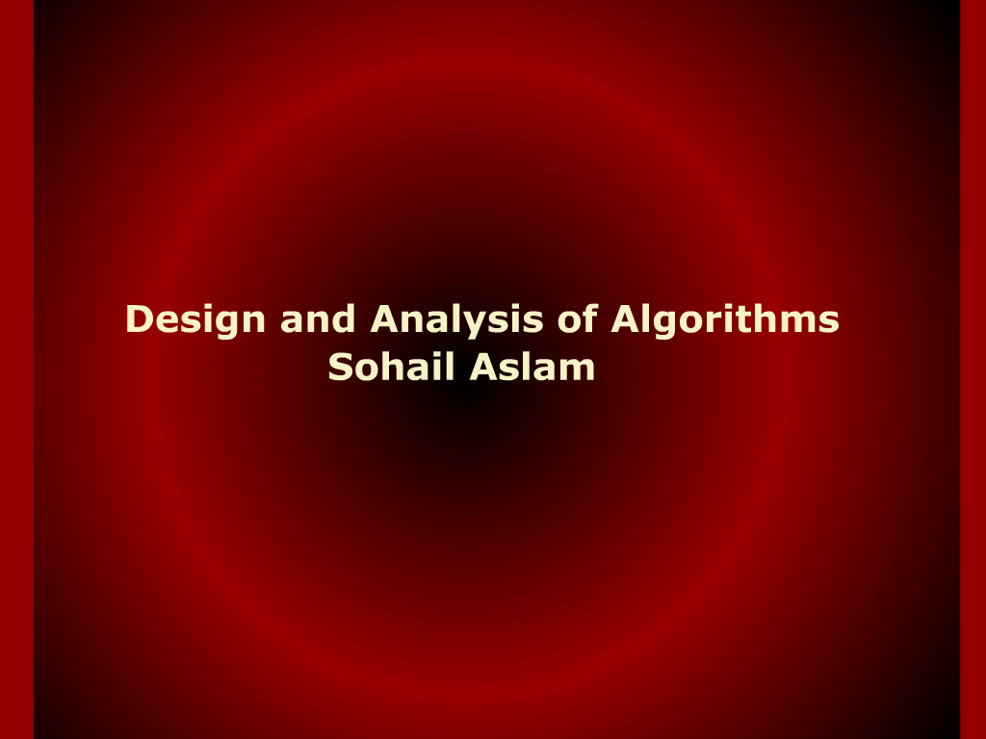
Design and analysis of Algorithms

Slide 3
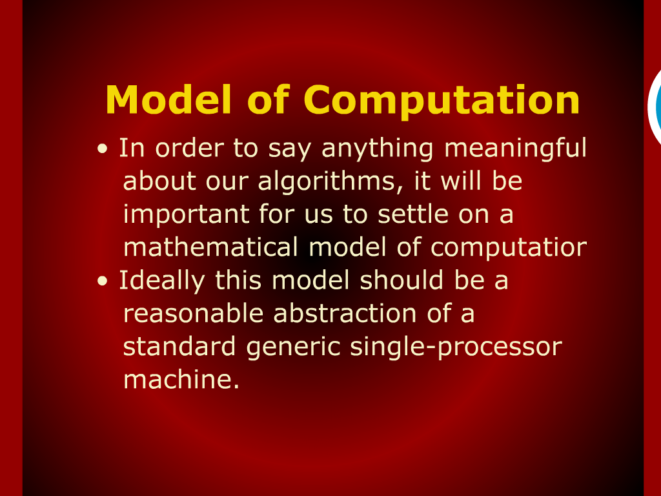
Model of Computation

Slide 4
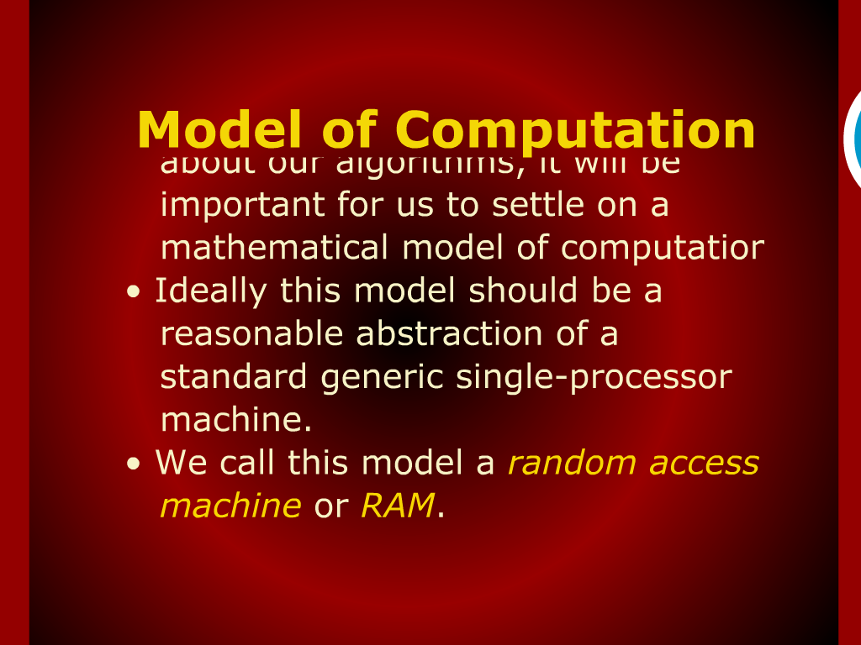
Model of Computation

Slide 5
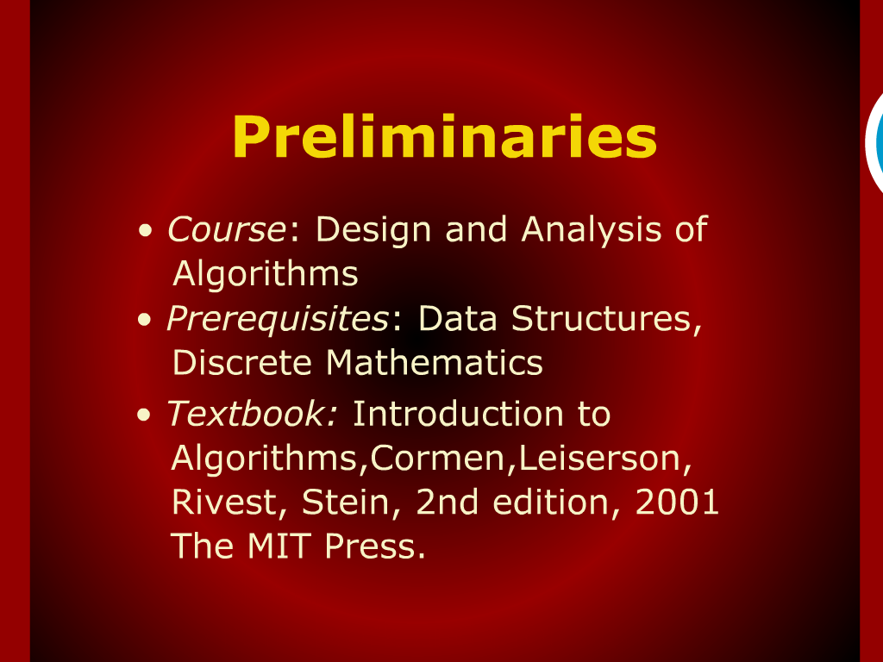
Preliminaries

Slide 6
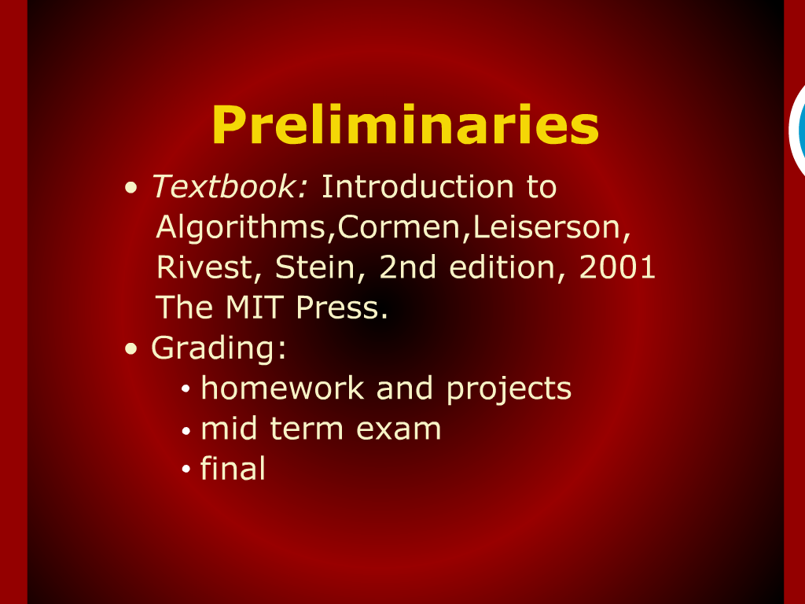
Preliminaries

Slide 7
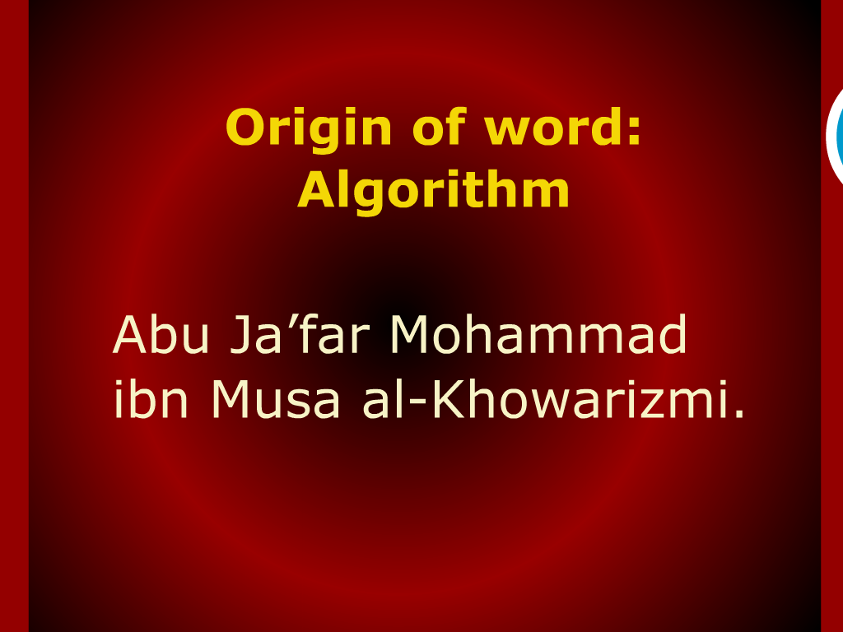
Origin of Word: ALGORITHM

Slide 8
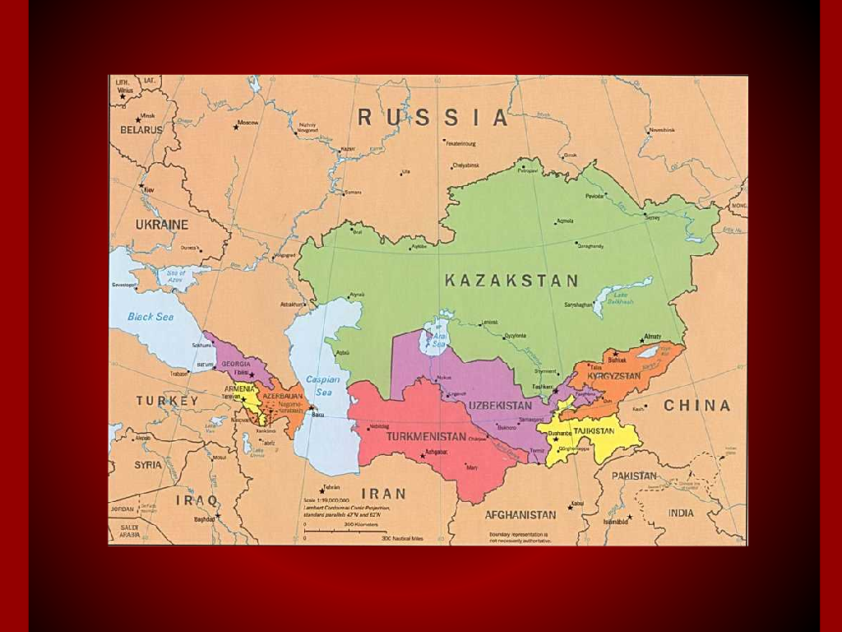
Origin of Word: ALGORITHM

Slide 9
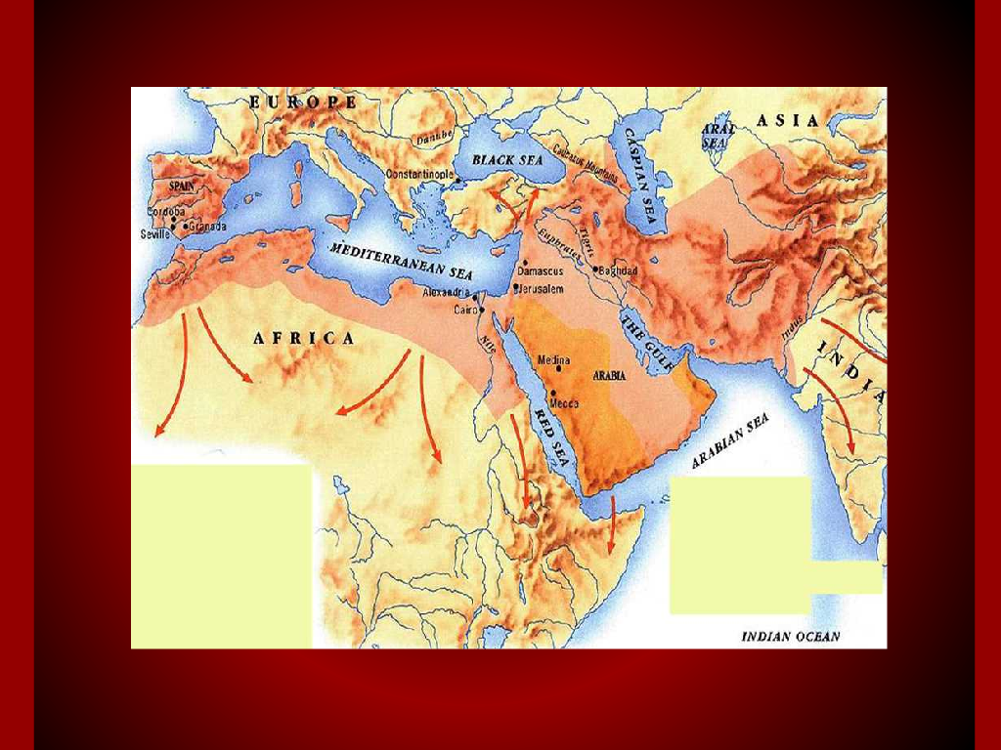
Origin of Word: ALGORITHM

Slide 10
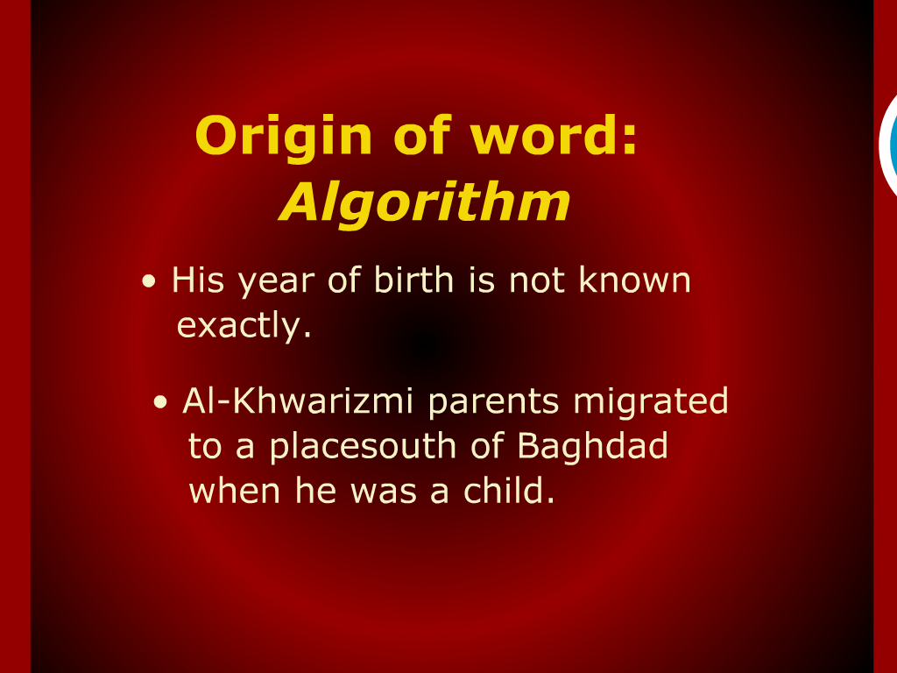
Origin of Word: ALGORITHM

Slide 11
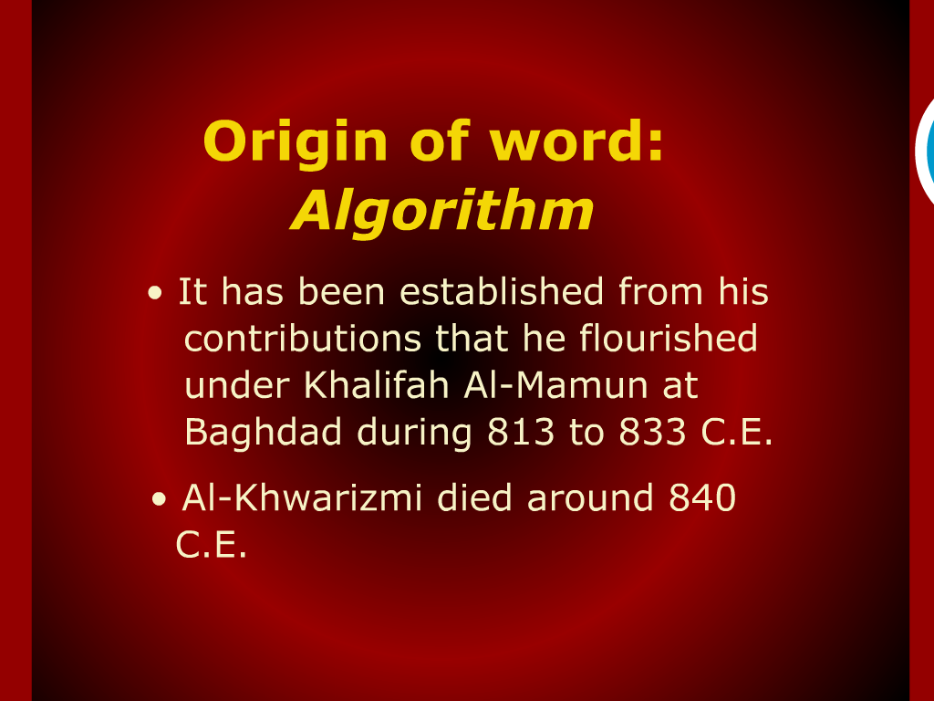
Origin of Word: ALGORITHM

Slide 12
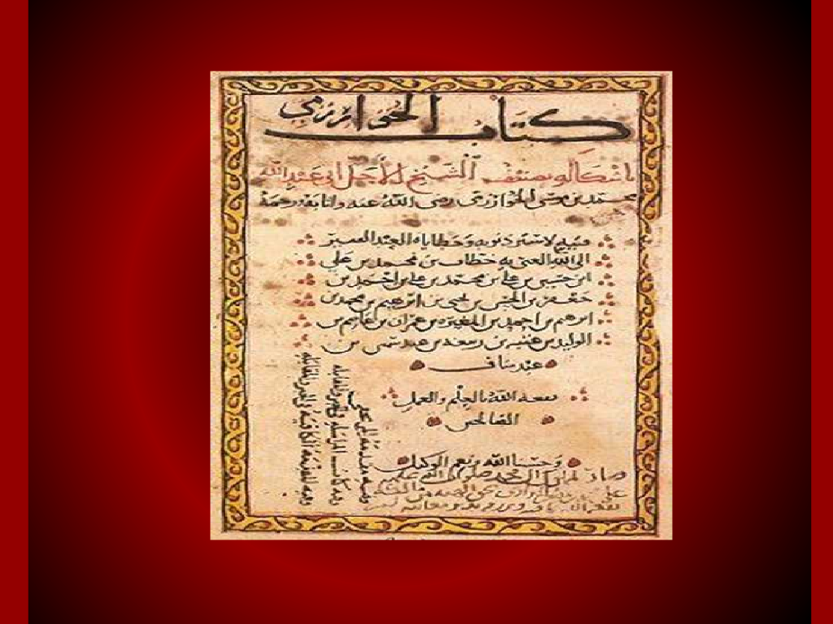
Origin of Word: ALGORITHM

Slide 13
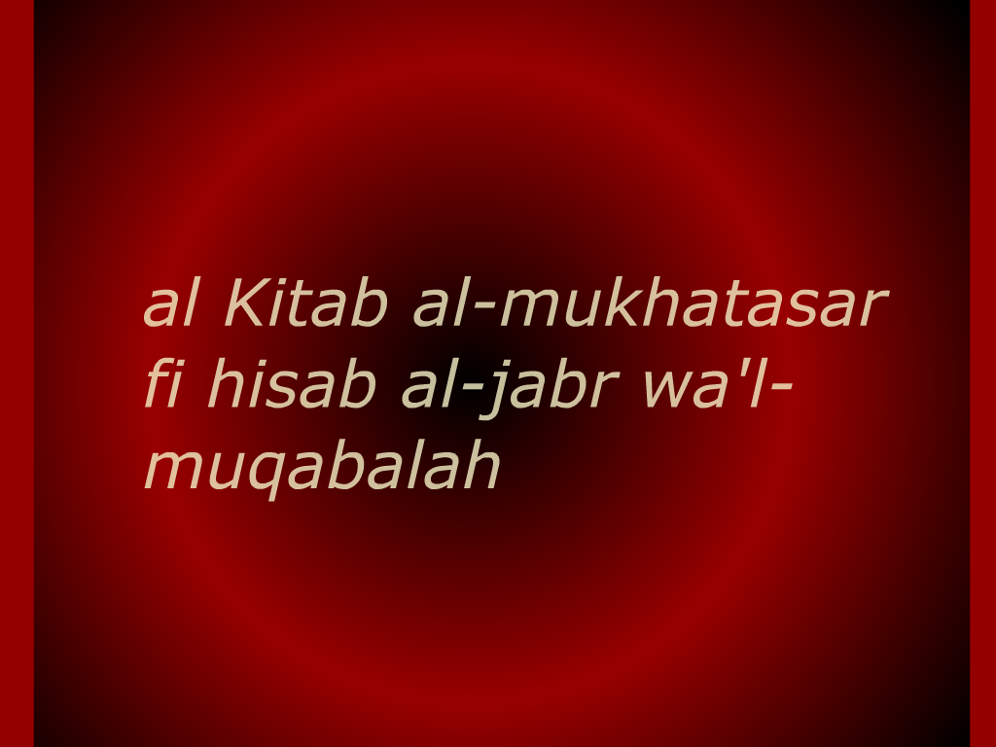
Origin of Word: ALGORITHM

Slide 14
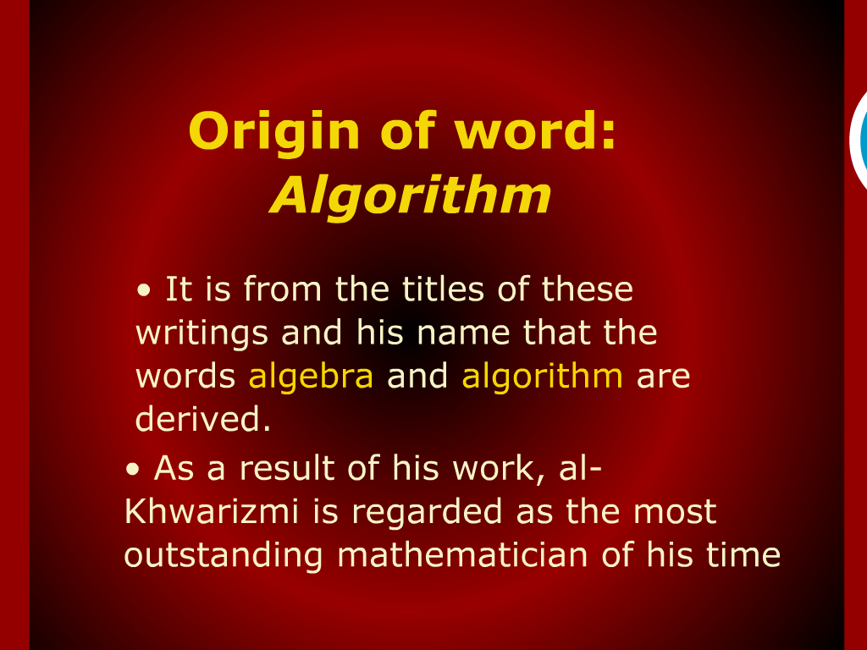
Origin of Word: ALGORITHM

Slide 15
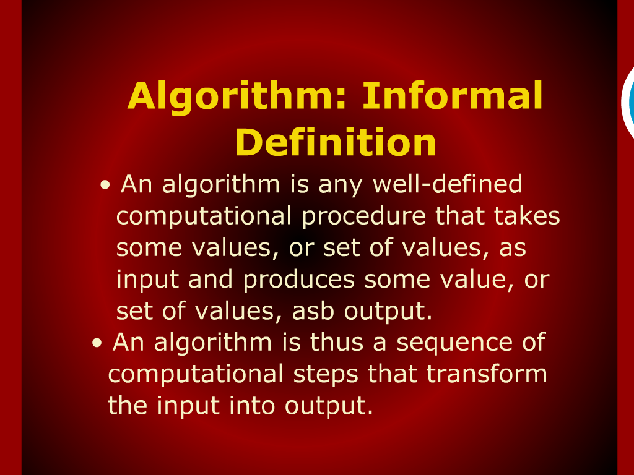
ALGORITHM informal definition

Slide 16
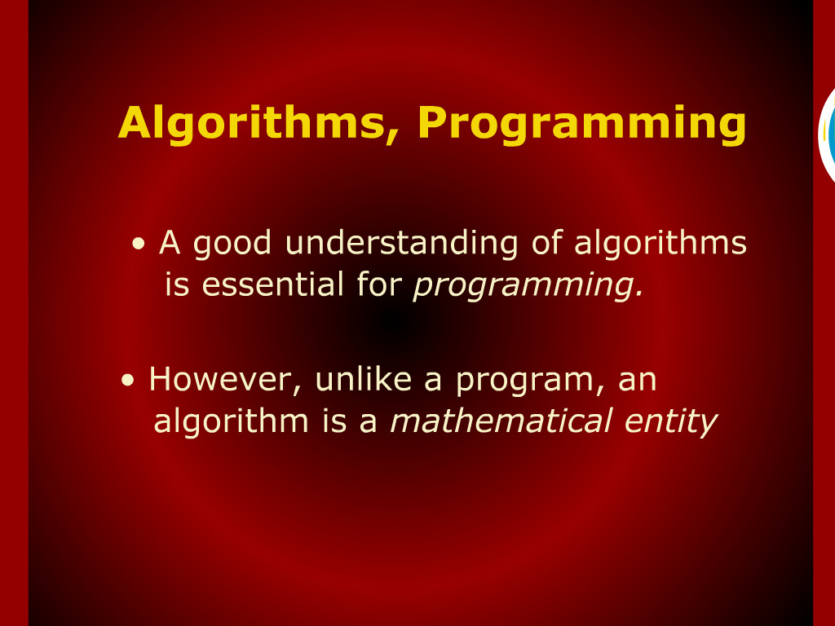
ALGORITHM, programming

Slide 17
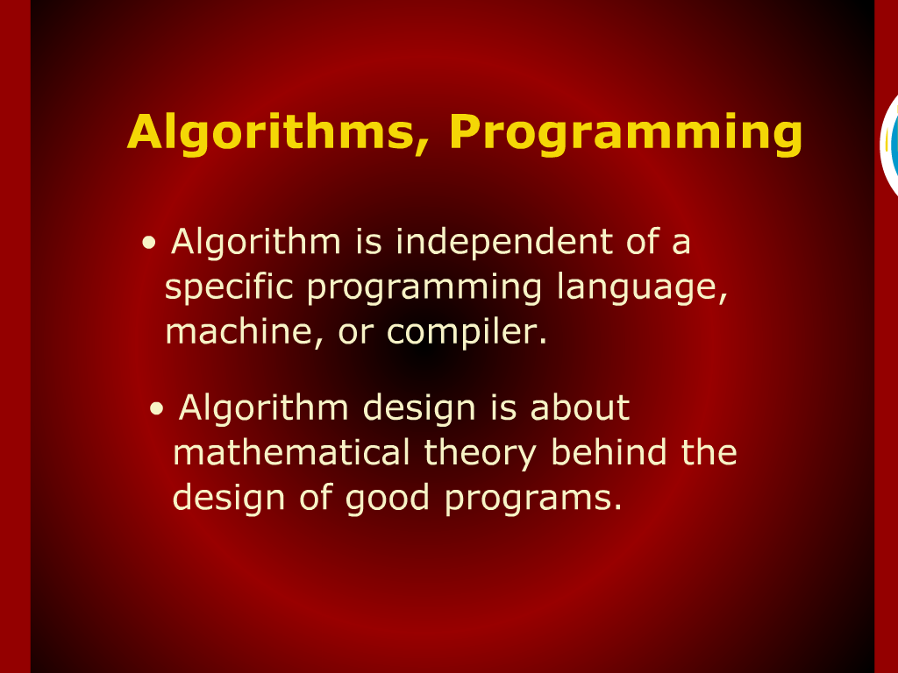
ALGORITHM, programming

Slide 18
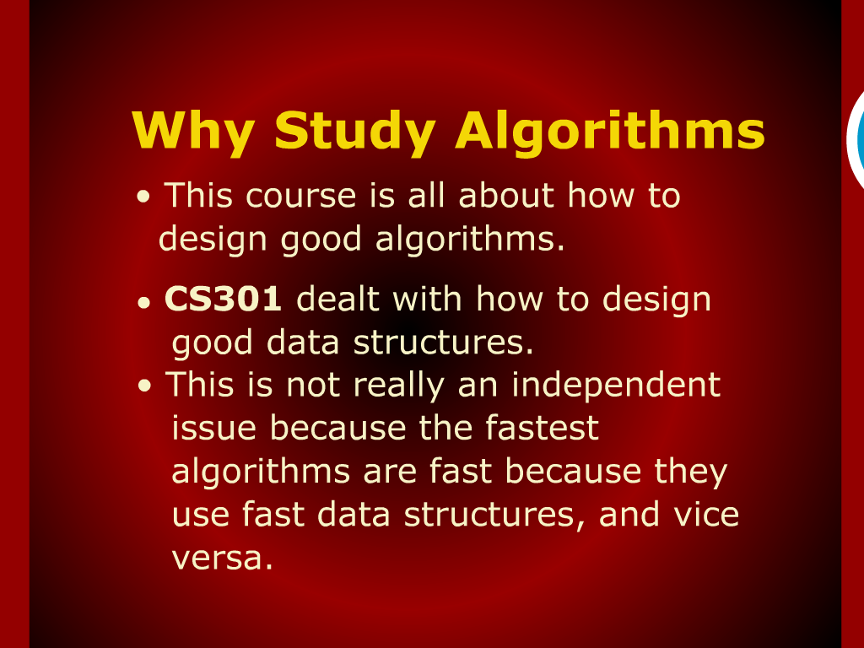
Why Study?

Slide 19
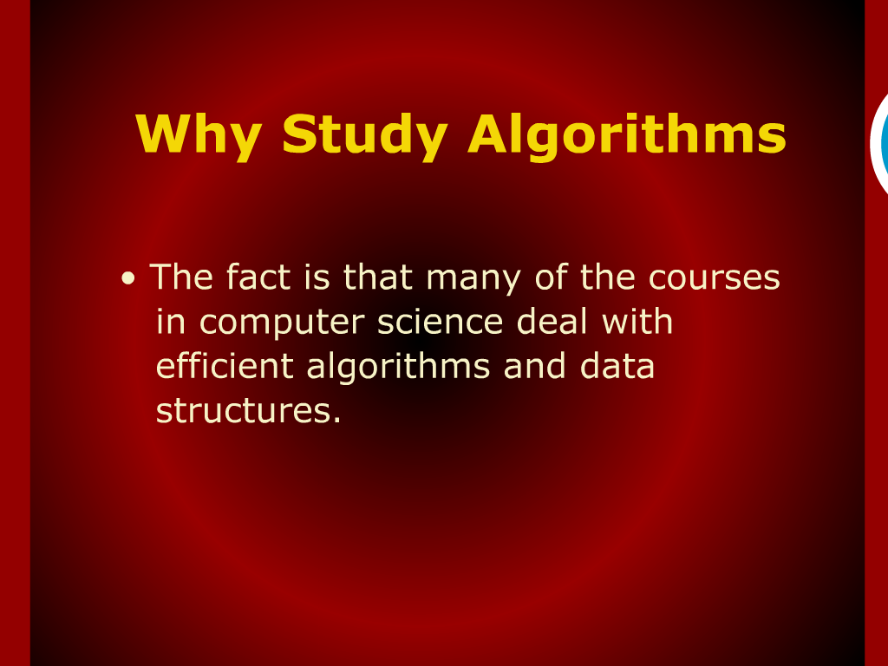
Why Study?

Slide 20
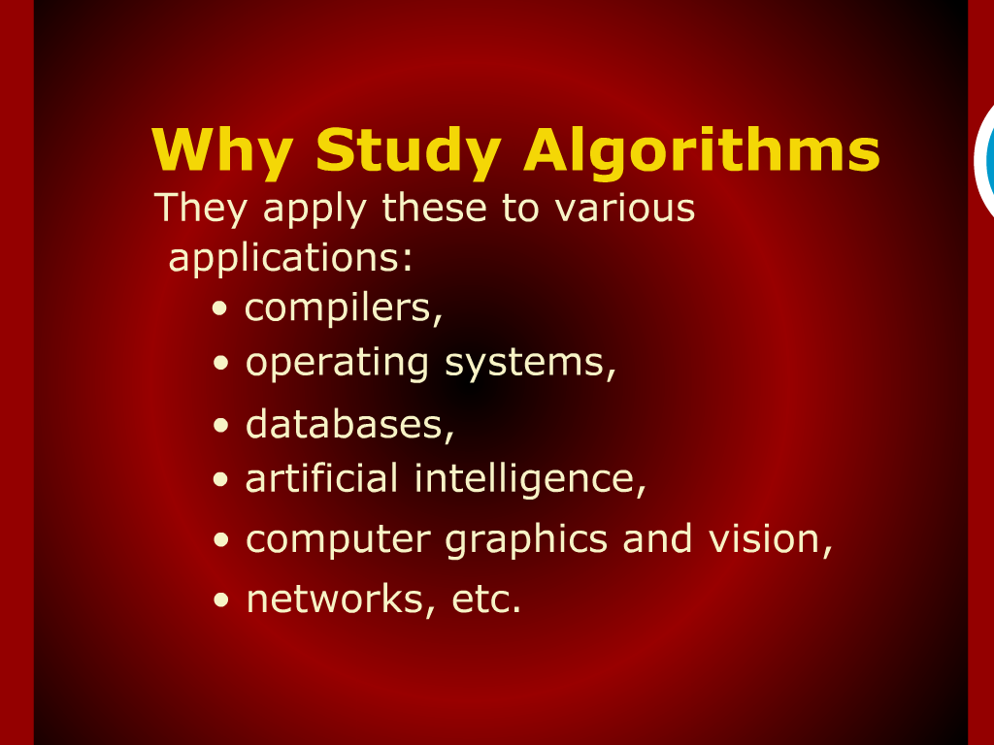
Why Study?

Slide 21
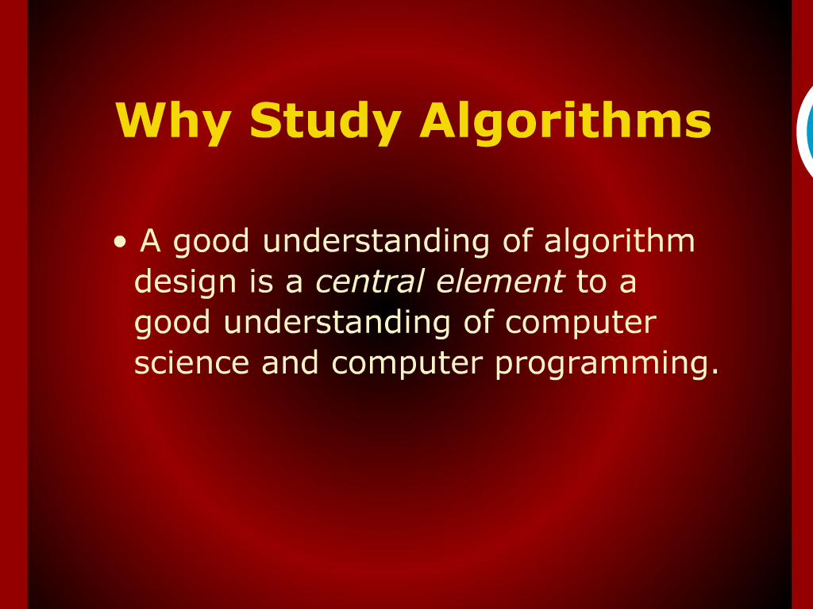
Why Study?

Slide 22
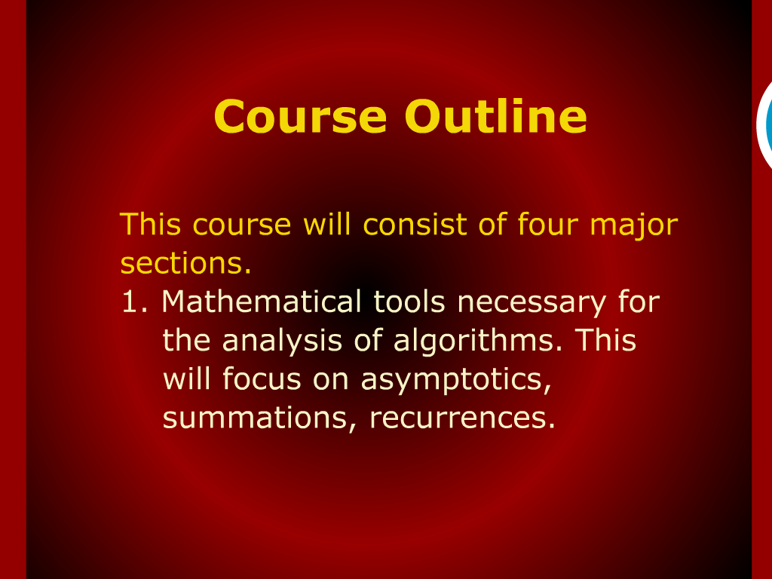
Course outline

Slide 23
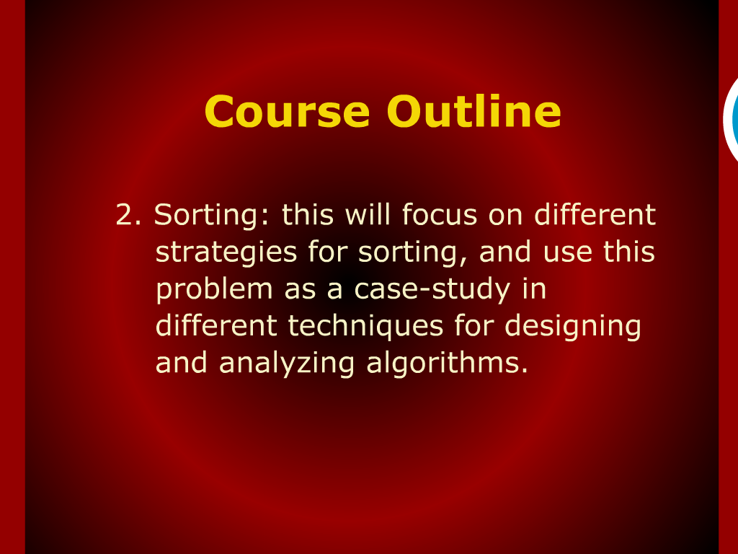
Course outline

Slide 24
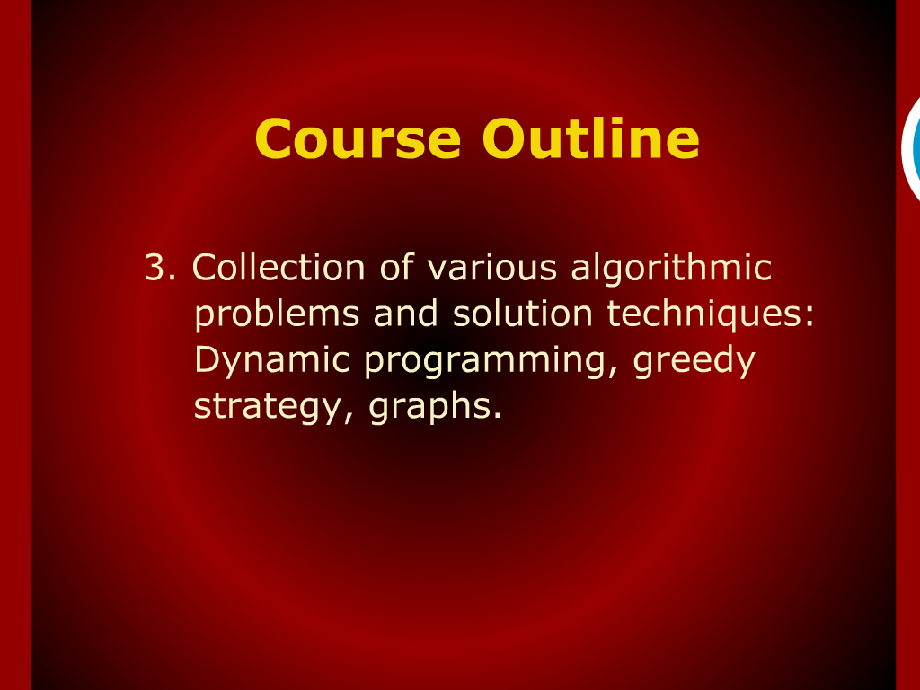
Course outline

Slide 25
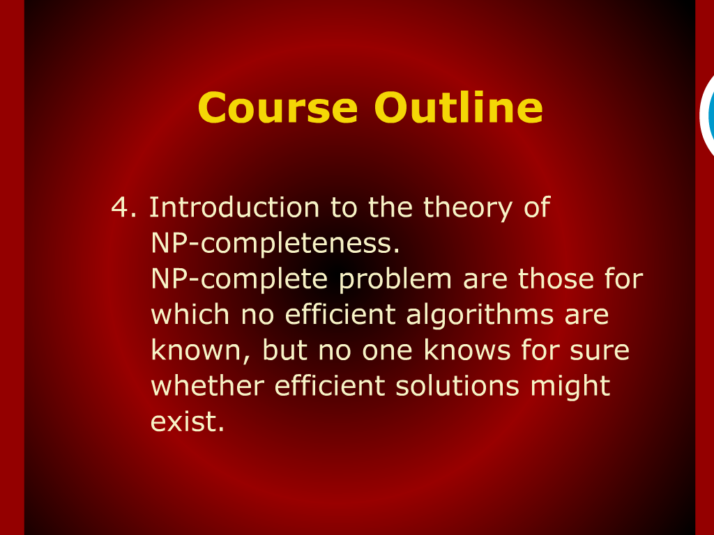
Course outline

Slide 26
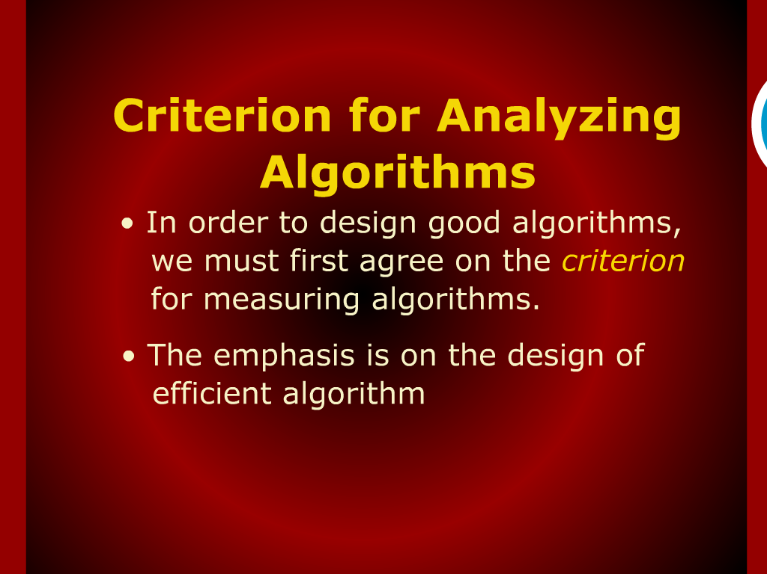
Criteria for analyzing Algorithms

Slide 27
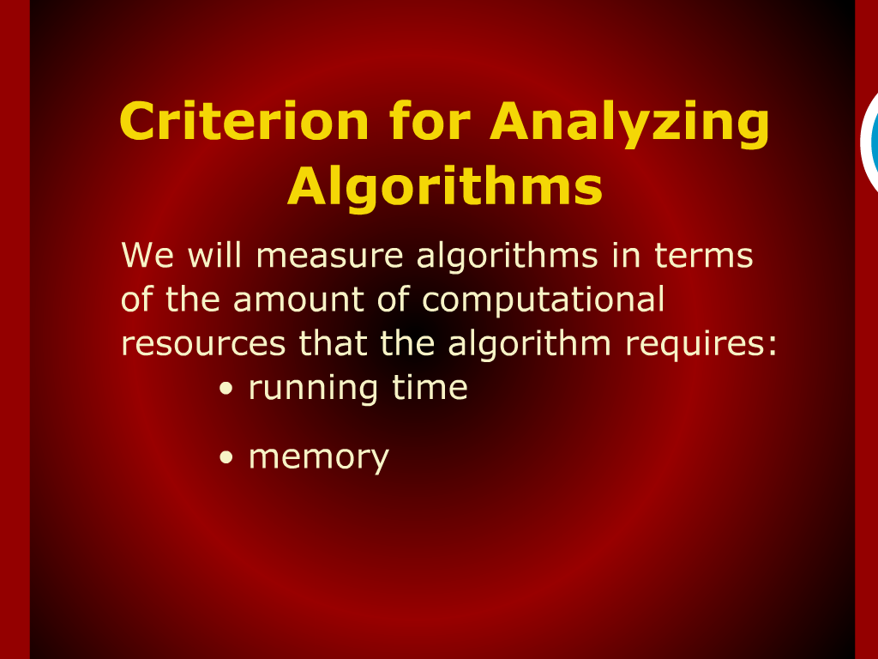
Criteria for analyzing Algorithms

Slide 28
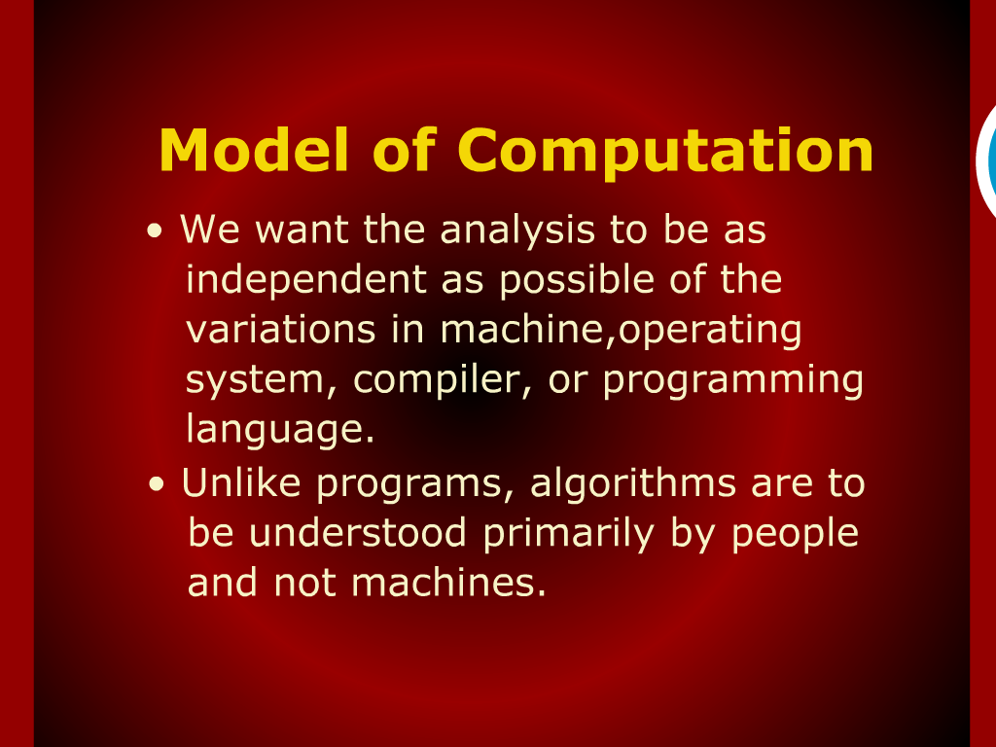
Model of Computation

Slide 29
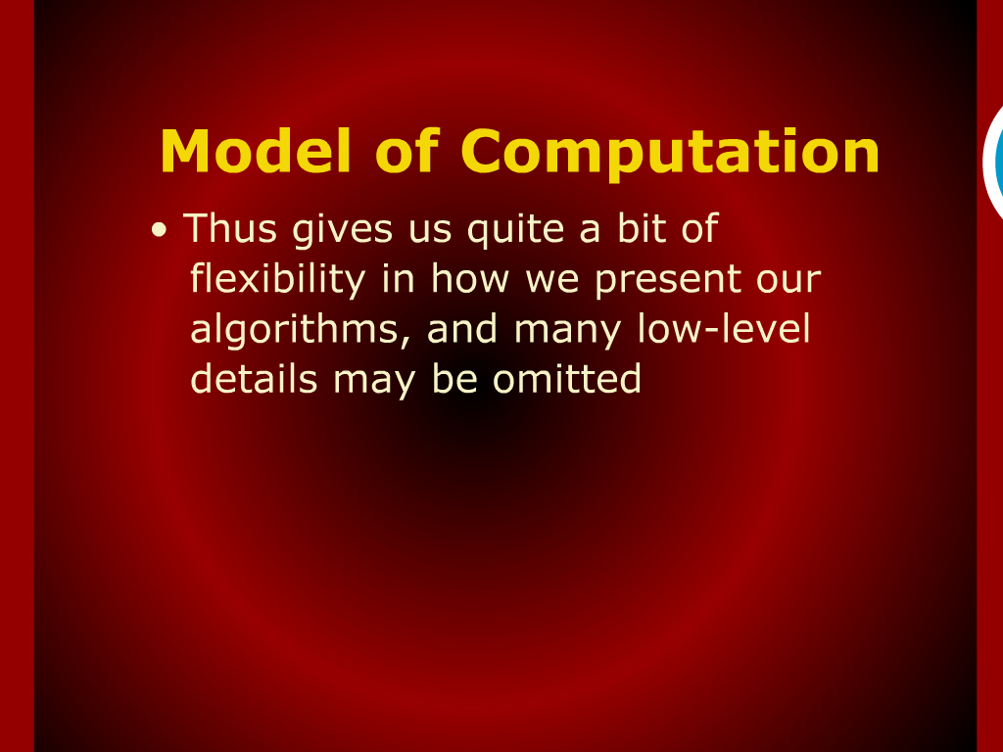
Model of Computation

Slide 30
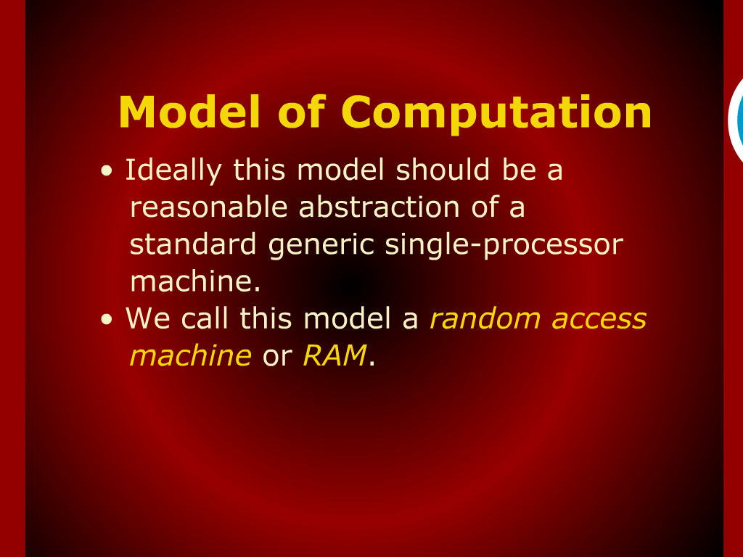
Model of Computation

Slide 31
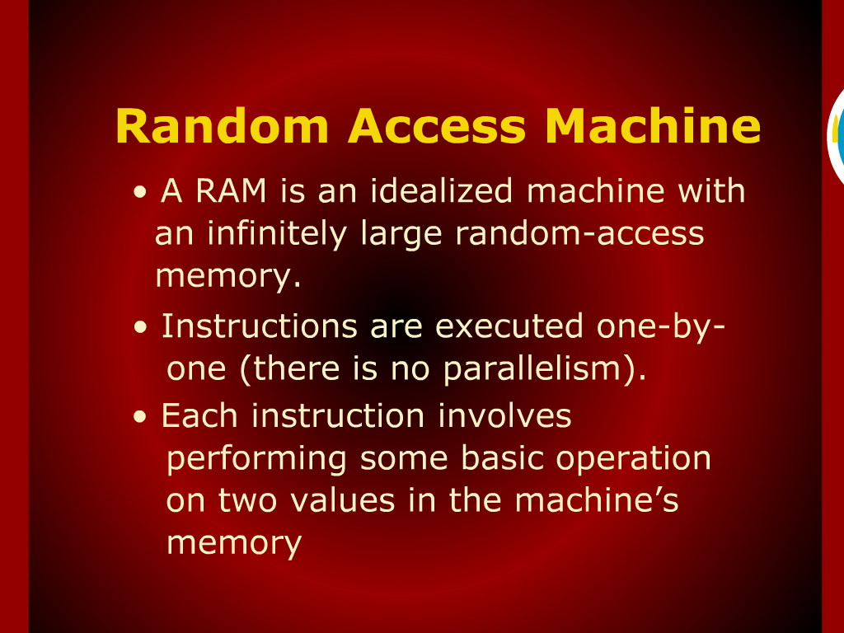
Random Access Machine

